Slide 1
Unit 3B
Human Form & Function
Body systems
The effects of trauma and aging

Slide 2

Study Guide
Read:
Our Human Species (3rd edtn)
Chapter 4, sections 15-17
Chapter 8, sections 14-15
Chapter 15, sections 10-12
Complete:
Human Biological Science Workbook
Topic 14 – The Effects of Trauma and Ageing

Slide 3
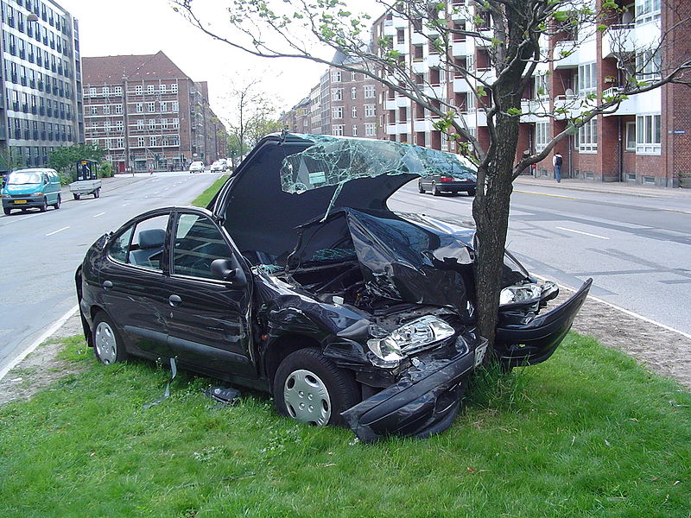
Damage to the musculoskeletal and nervous systems can result from disease, trauma or ageing.

Slide 4
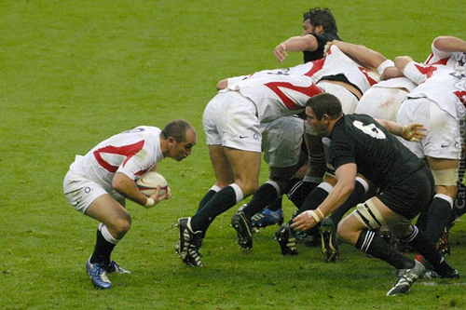
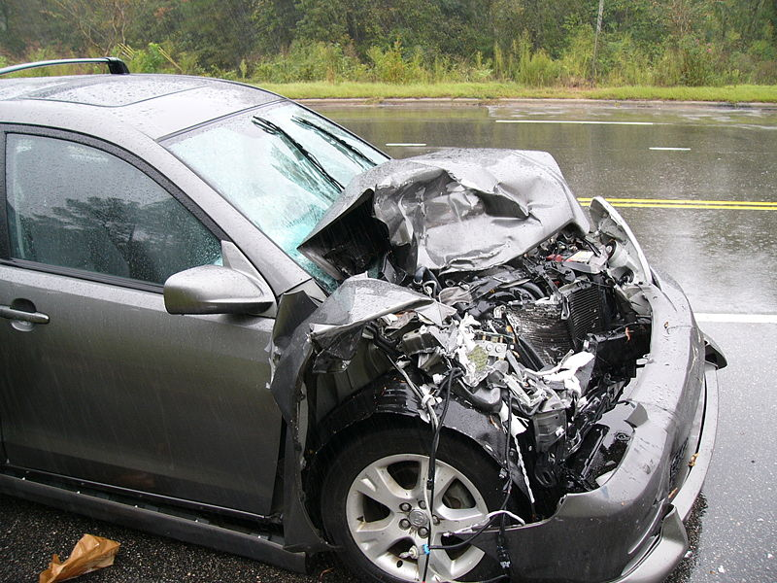
Many trauma injuries, especially in young people, result from sport and vehicle accidents.
Caroline Mockett
Robert Howell

Slide 5
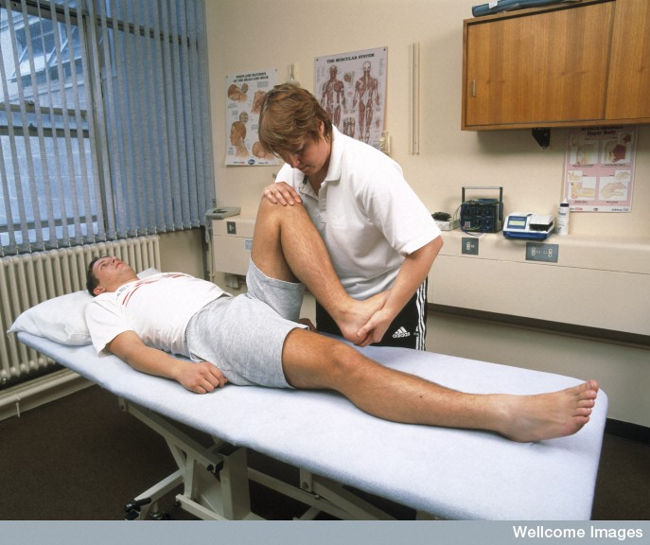
Soft tissue injuries
Many minor injuries involve the soft tissues – i.e. torn muscles, ligaments and tendons.
Most soft tissue injuries respond to rest and/or physiotherapy. Serious injuries may require surgery (e.g. knee reconstruction).
Wellcome Library

Slide 6
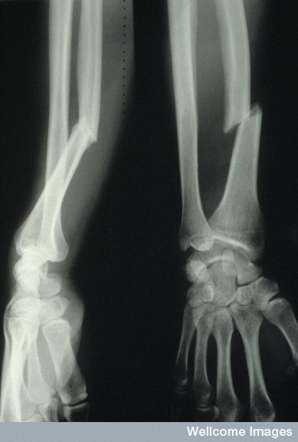
Serious injuries
Trauma resulting from sport and vehicle accidents can result in broken bones and damage to the central nervous system e.g. concussion, coma or paralysis.
Wellcome Photo Library

Slide 7
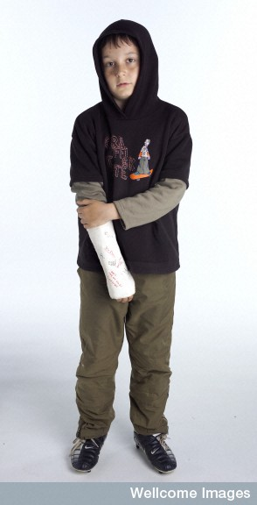
Simple fractures
Simple fractures can usually be treated by splinting or supporting the damaged bone with a plaster cast. These injuries generally heal in a few weeks.

Slide 8
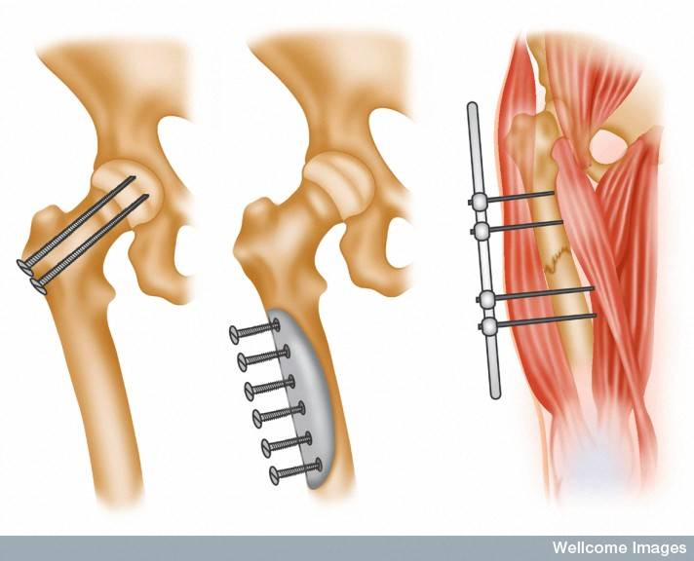
With serious fractures the bone may need to be rebuilt using screws, pins and plates.
Wellcome Photo Library

Slide 9
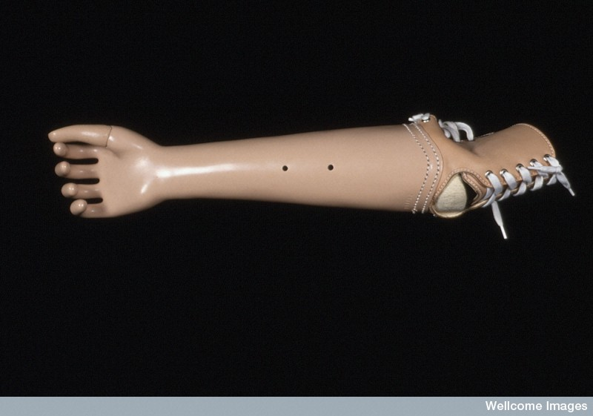
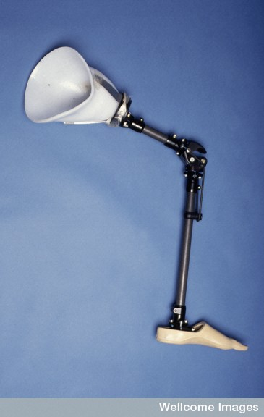
Amputation
In extreme situations, the limb may have to be amputated. When this occurs most people elect to have a prosthesis, or artificial limb, fitted.
Currently, progress is being made in the development of robotic limbs.
Wellcome Photo Library

Slide 10
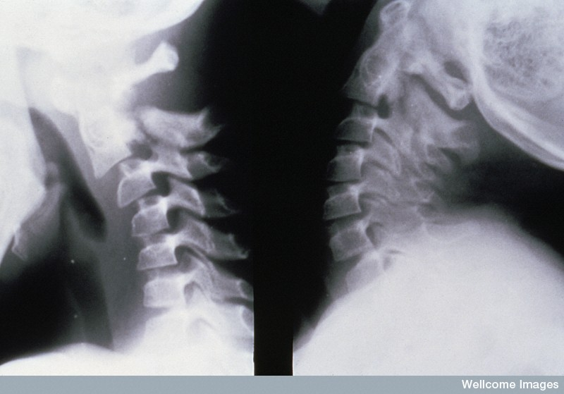
Spinal cord injuries
Hangman’s fracture
Wellcome Photo Library
Injuries to the spinal cord in the thoracic or lumbar regions can result in paraplegia - a loss of movement and sensation in the lower part of the body.
Damage to the spinal cord in the neck region often results in quadriplegia (tetraplegia), which involves loss of movement and sensation in both the arms and legs.

Slide 11
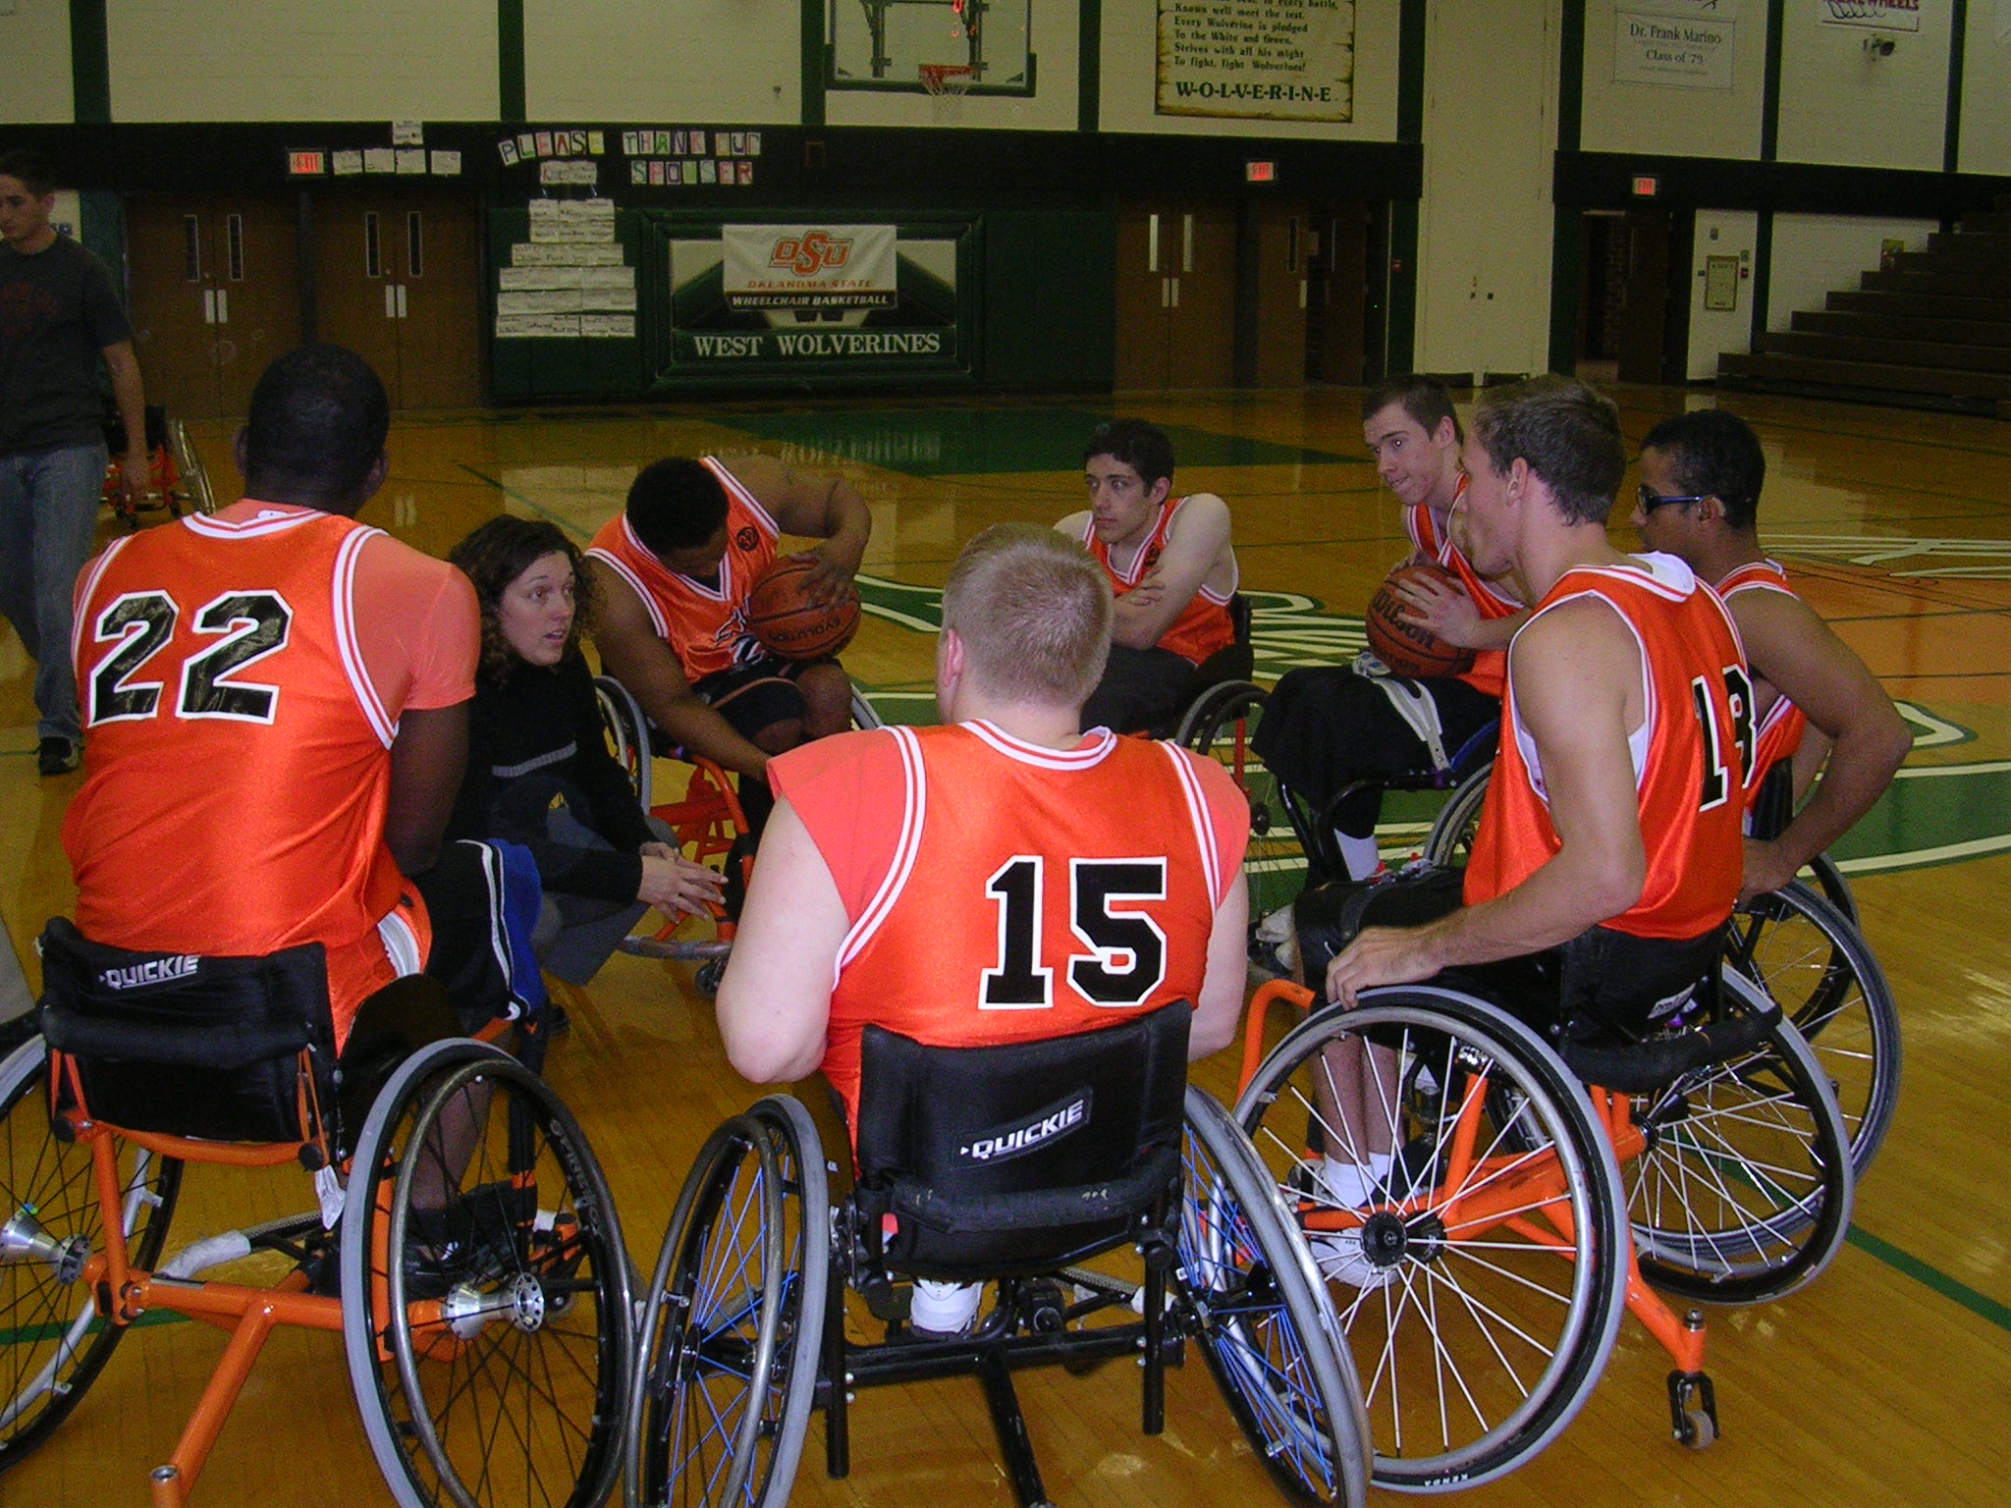
Treatment of spinal injuries
Currently, damage to the spinal cord cannot be repaired.
It is hoped that, in the future, stem cell technology will enable doctors to treat patients with spinal cord and brain injuries.
Despite being confined to wheelchairs, many people with spinal cord injuries are able to lead active lives.

Slide 12
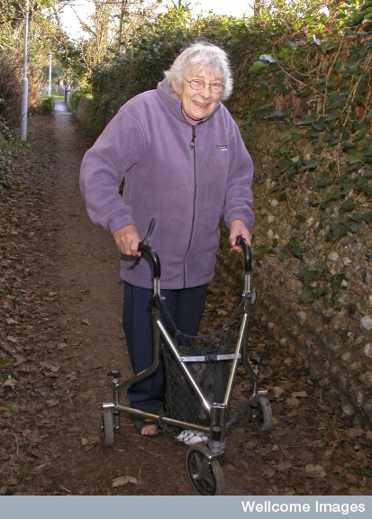
Ageing
Ageing is frequently accompanied by a degeneration of joints and bones. It is also characterised by a deterioration of the nervous system.
Libby Welch, Wellcome Images

Slide 13
Osteoporosis
Osteoporosis is a bone disease most common in postmenopausal women.
It is characterised by a loss of bone tissue resulting in the bones becoming extremely porous and fragile.
People with osteoporosis are at greater risk of experiencing a bone fracture.

Slide 14
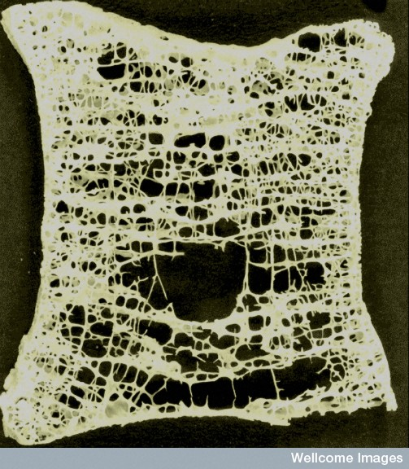
Diagnosis
Thin slice of an osteoporotic vertebra from an 89 year old woman.
Osteoporosis most commonly results from a fall in estrogen levels after menopause.
A drop in bone mineral density (BMD) can be detected using dual energy X-ray absorptiometry.
Prof Alan Boyde, Wellcome Images

Slide 15
Treatment
The risk of developing osteporosis can be reduced by:
  Exercise
  Using dietary supplements of calcium and vitamin D
  Estrogen replacement therapy in some situations
There are several medications effective in the management of osteoporosis, especially bisphosphonates.

Slide 16
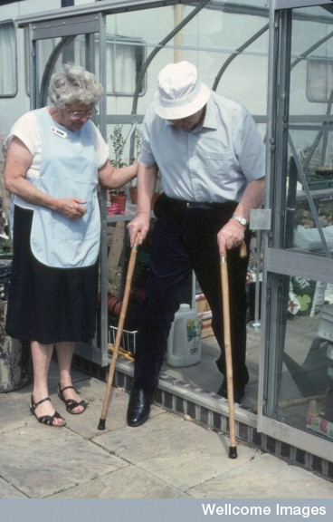
Osteoarthritis
Osteoarthritis is a degenerative joint disease that occurs mainly in older people.
More than 50% of people over the age of 50 report painful knee joints.
Wellcome Photo Library

Slide 17
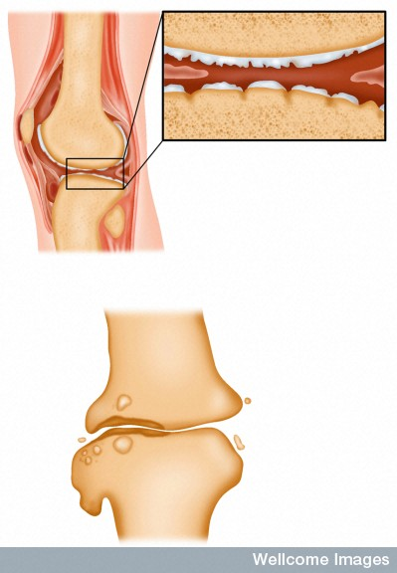
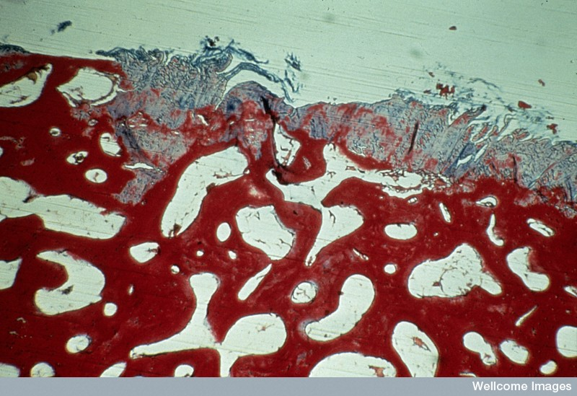
Section of a joint showing severe damage to the articulating cartilage.
Wellcome Photo Library
Osteoarthritis is the most common form of arthritis and results from a progressive breakdown of cartilage in the joints, leading to pain and stiffness.

Slide 18
Medications
Weight control and exercise have been shown to be beneficial in the management of the illness.
Symptoms of osteoarthritis can be treated with paracetamol or non-steroidal anti-inflammatory drugs (though not if you are at very high risk of heart disease or ulcers).
Injections of hyaluronan, extracted from rooster combs, and glucosamine sulphate, are reported to have beneficial effects on the symptoms and progression of the disease.
Trials into the effectiveness of chondroitin are contradictory

Slide 19
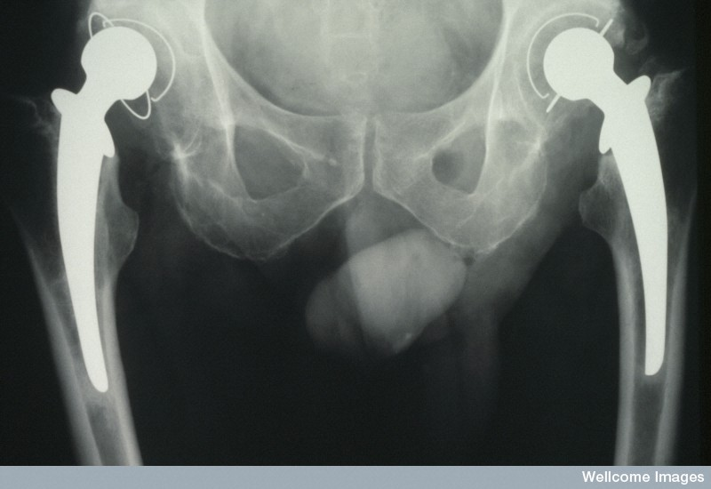
Surgery
In severe cases there are three main surgical options.
Arthroscopy - involves washing out the joint and trimming down the damaged cartilage (shown to be of little benefit in most cases).
Operations to improve the biomechanics of the joint. These include:
  osteotomy, which improves the alignment of the knee joint.
  cartilage cell implantation which aims to restore normal knee biology.
Joint replacement.
Wellcome Photo Library

Slide 20
Alzheimer’s disease
Alzheimer’s disease (AD) is the most common cause of dementia among older people.
AD is characterised by progressive and irreversible mental deterioration. It gradually destroys memory and thinking skills, and eventually even the ability to carry out the simplest tasks.

Slide 21
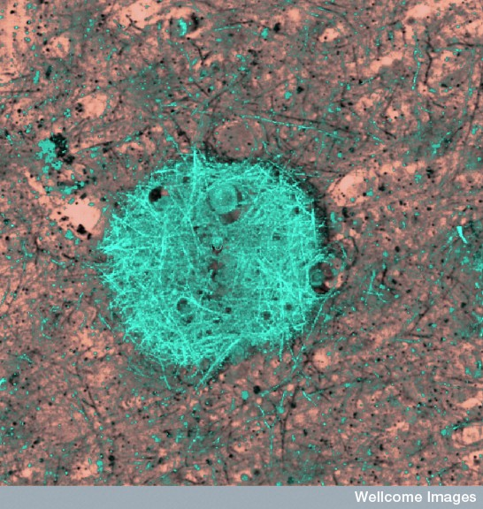
Plaques and tangles
People with Alzheimer’s disease have abnormal clumps (amyloid plaques) and tangled bundles of fibers (neurofibrillary tangles) in the brain.
Image of an Alzheimer's brain showing a
region of amyloid plaque.
Med Mic Sciences Cardiff Uni, Wellcome Images

Slide 22
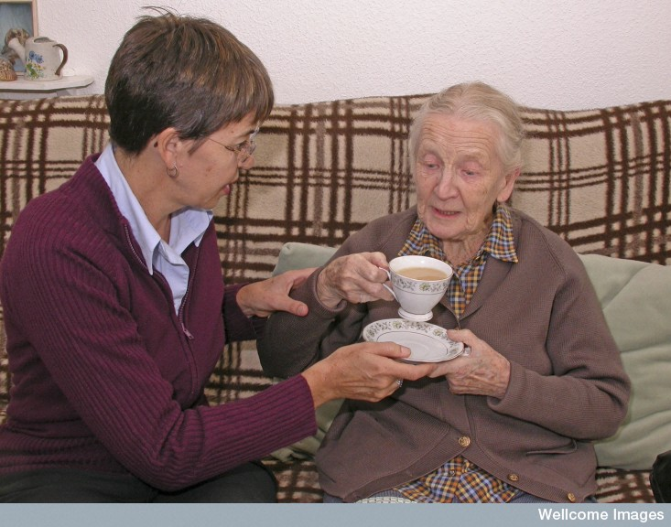
Libby Welch,
Wellcome Images
In the early stages of Alzheimer’s disease plaques and tangles destroy the memory centers of the brain.
As the disease progresses other important areas of the brain are affected causing brain tissue to shrink significantly.

Slide 23
Treatment
Alzheimer’s is terminal and there is no cure.
Drugs are available to manage the symptoms of the illness and slow its progress.
Remaining physically and mentally active have been shown to be significant in reducing the risk of developing Alzheimer’s disease.

Slide 24
Parkinson’s disease
Parkinson disease is:
a degenerative disorder of the brain.
caused by the destruction of dopamine-producing cells in the basal nuclei of the cerebrum.

Slide 25
Symptoms
Parkinson’s disease:
typically affects people over the age of 50.
Is characterised by:
  slowed physical and mental responses
  muscular tremors
  stiffness of the limbs and trunk
  impaired balance and coordination
  plus a variety of other symptoms .

Slide 26
Treatment
At present there is no cure for Parkinson’s disease.
Symptoms of the disease can be treated using:
a variety of medications
surgery In some severe cases
deep brain stimulation (using a small electrical pulse generator) has had encouraging results in some cases.

Slide 27
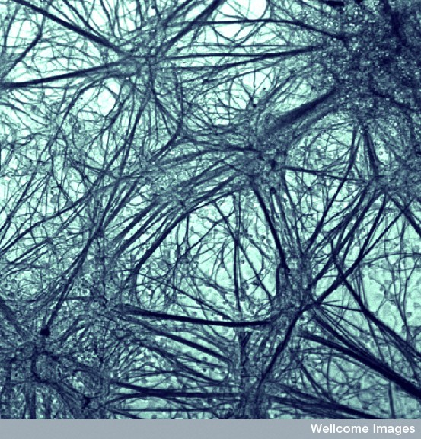
Cure?
Although there is currently no cure for Parkinson’s disease, doctors hope that neurones derived from embryonic stem cells, such as these, could form the basis of future treatments.
A network of neurones in culture that have
differentiated from embryonic stem cells.
Q-L Ling & A Smith, Wellcome Images

Slide 28
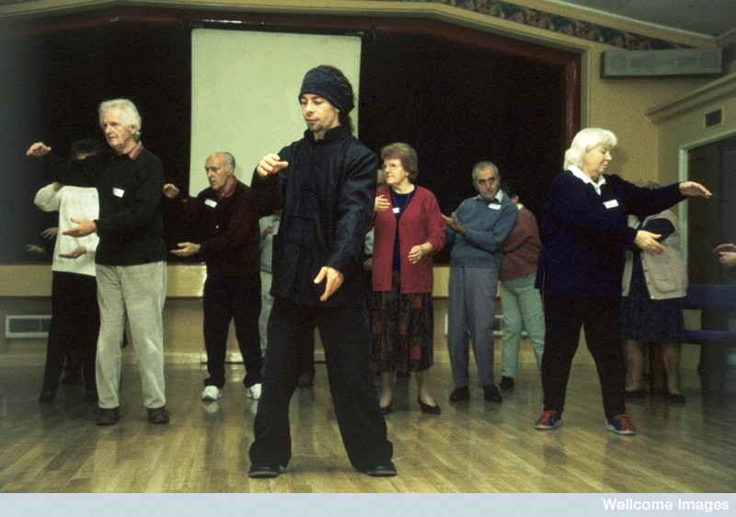
Parkinson’s disease
Libby Welch,
Wellcome Images
The slow movements of T'ai Chi are highly beneficial to Parkinson's disease sufferers.

